Slide 1
GSFC Thermal Model – Normalized to 1 AU
D.A.Quinn - 140507

Slide 2
AHEAD – GSFC Thermal Model
Set Soft Stop = 8.216°
10/31/2014
Set Offset = 3.1°
10/1/2015
Set Offset = 3.1°
7/30/2014
D.A.Quinn - 140507

Slide 3
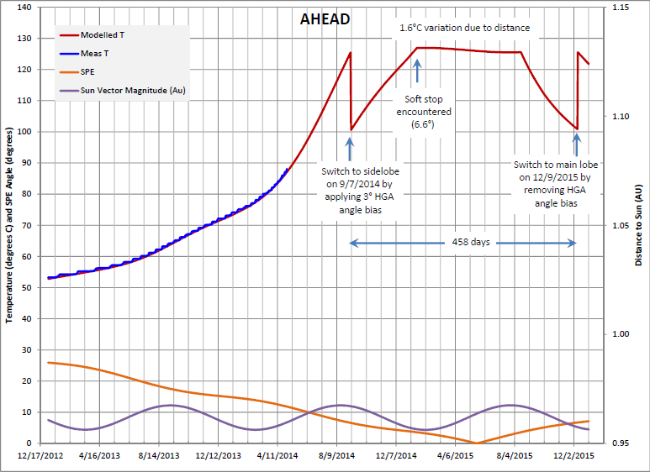
AHEAD – Dan Wilson’s Curve Fit
D.A.Quinn - 140507

Slide 4
BEHIND – GSFC Thermal Model
Set Soft Stop = 7.56°
1/4/2015
DRAFT
Set Offset = 4°
11/25/2014
D.A.Quinn - 140507

Slide 5
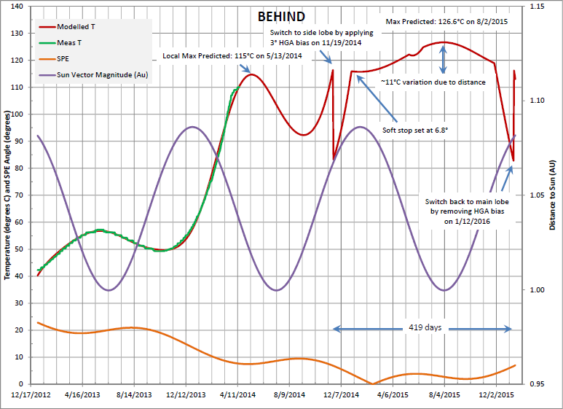
BEHIND – Dan Wilson’s Curve Fit
D.A.Quinn - 140507

Slide 6
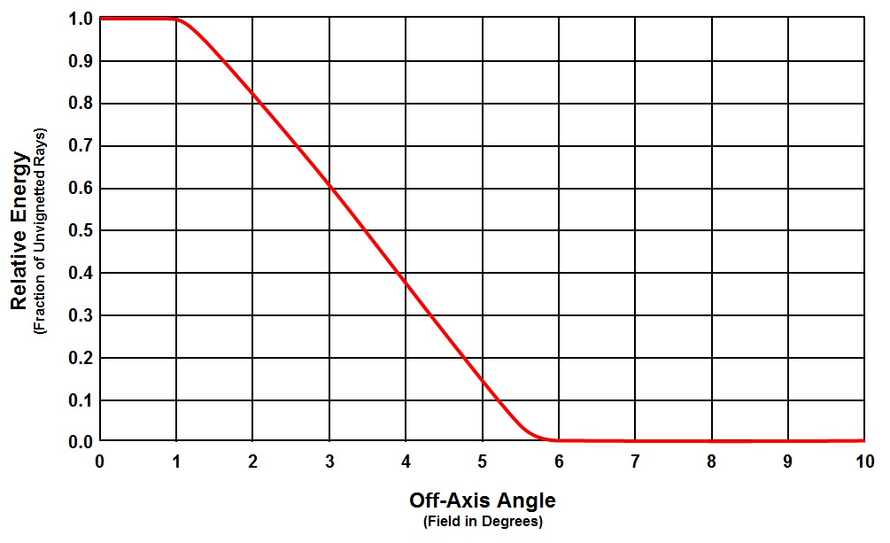
GSFC Optical model
D.A.Quinn - 140507

Slide 7
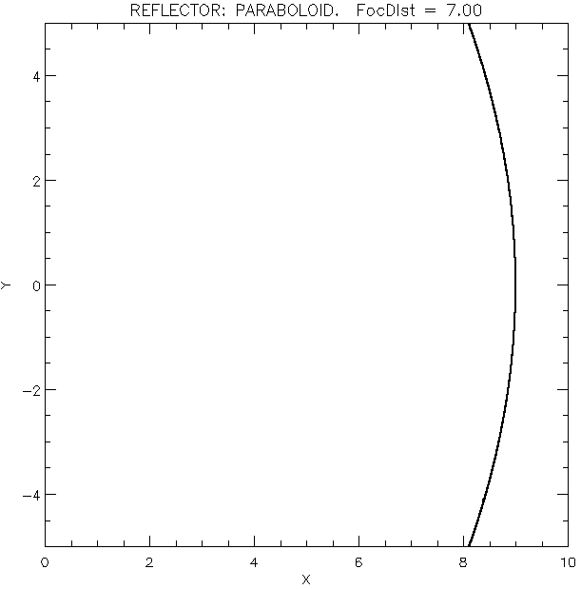
Offset = +5°
D.A.Quinn - 140507

Slide 8
Offset = +3°
D.A.Quinn - 140507

Slide 9
Offset = 0°
D.A.Quinn - 140507

Slide 10
Offset = -3°
D.A.Quinn - 140507

Slide 11
Offset = -5°
D.A.Quinn - 140507

